Slide 1
Section 11.5
Rotation of Axes;
General Form of a Conic
Copyright © 2012 Pearson Education, Inc. Publishing as Prentice Hall.

Slide 2

Copyright © 2012 Pearson Education, Inc. Publishing as Prentice Hall.

Slide 3

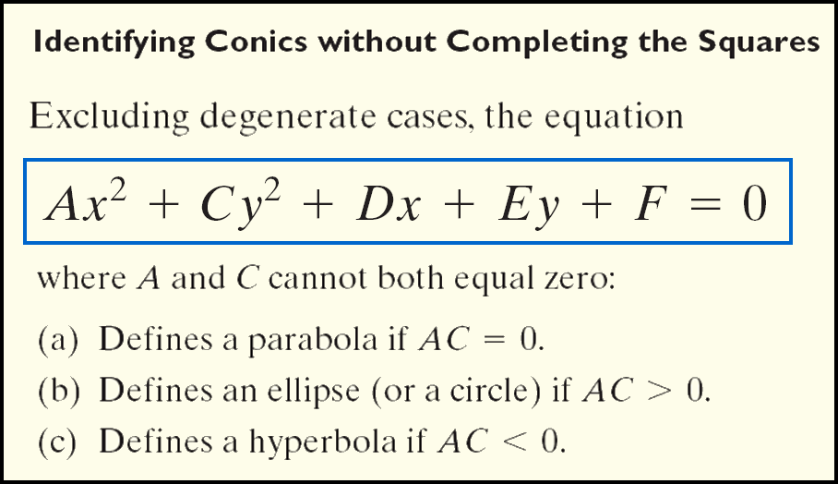
Copyright © 2012 Pearson Education, Inc. Publishing as Prentice Hall.

Slide 4

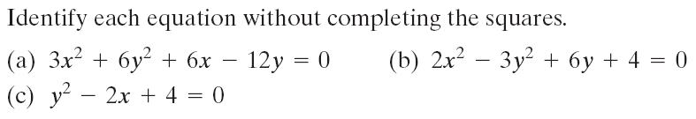
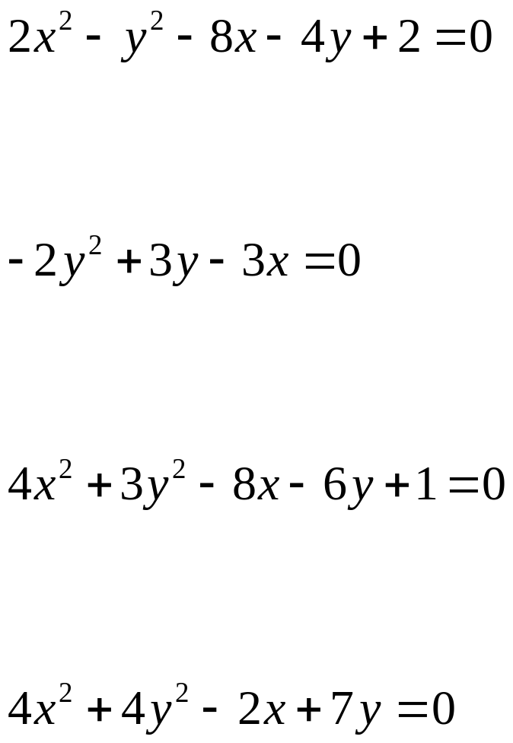




Copyright © 2012 Pearson Education, Inc. Publishing as Prentice Hall.

Slide 5
Copyright © 2012 Pearson Education, Inc. Publishing as Prentice Hall.

Slide 6
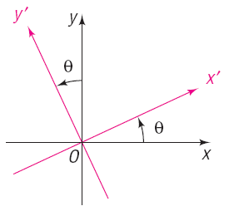
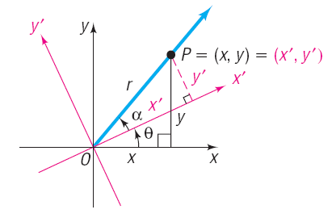

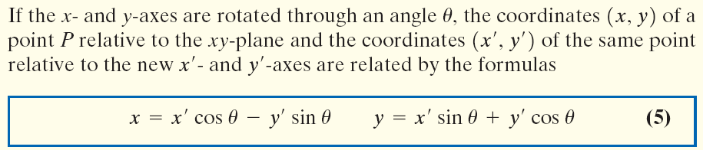
Copyright © 2012 Pearson Education, Inc. Publishing as Prentice Hall.

Slide 7



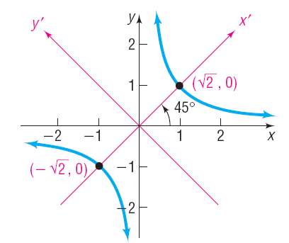



Copyright © 2012 Pearson Education, Inc. Publishing as Prentice Hall.

Slide 8
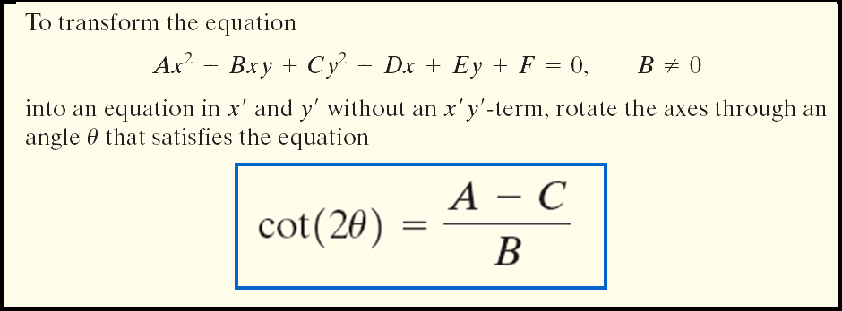
Copyright © 2012 Pearson Education, Inc. Publishing as Prentice Hall.

Slide 9
Copyright © 2012 Pearson Education, Inc. Publishing as Prentice Hall.

Slide 10




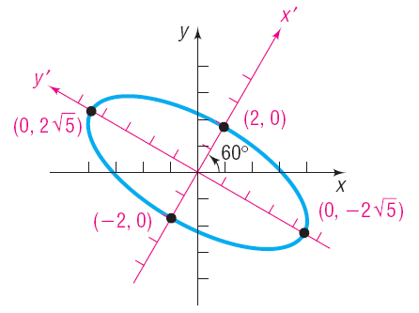


Copyright © 2012 Pearson Education, Inc. Publishing as Prentice Hall.

Slide 11


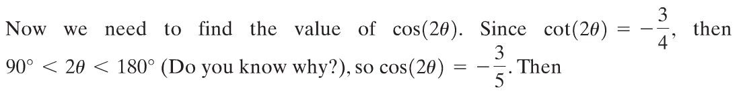
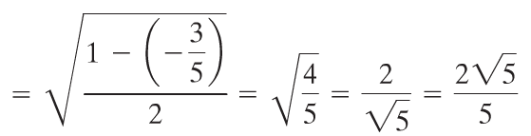

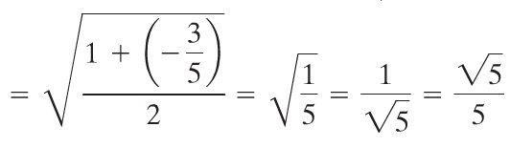
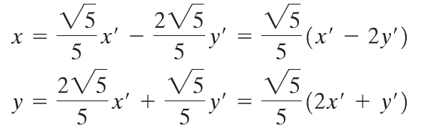
Copyright © 2012 Pearson Education, Inc. Publishing as Prentice Hall.

Slide 12
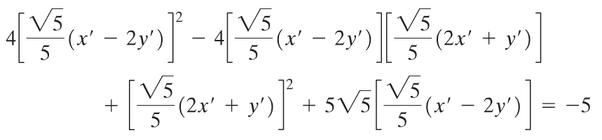
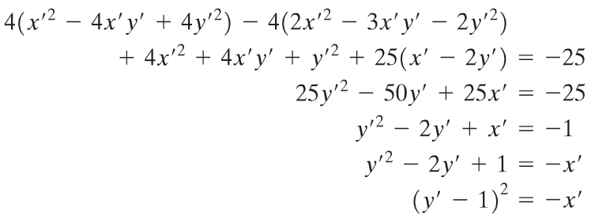
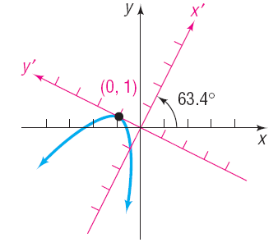
Copyright © 2012 Pearson Education, Inc. Publishing as Prentice Hall.

Slide 13
Copyright © 2012 Pearson Education, Inc. Publishing as Prentice Hall.

Slide 14
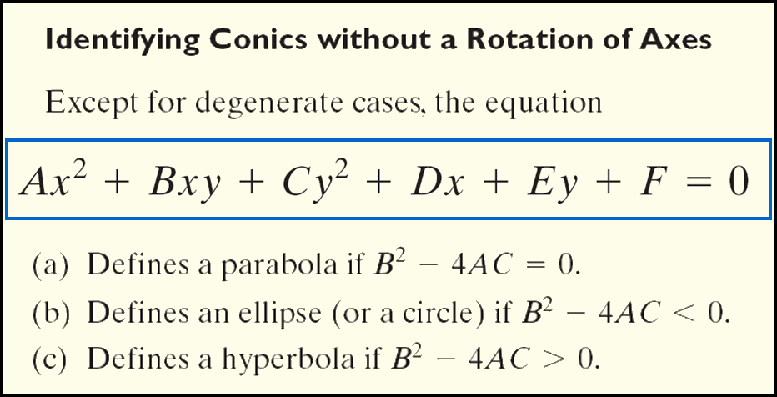
Copyright © 2012 Pearson Education, Inc. Publishing as Prentice Hall.

Slide 15
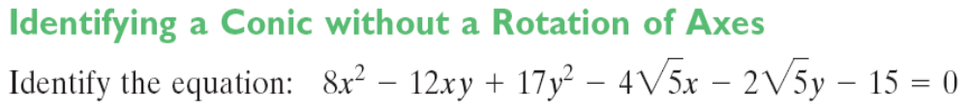

Copyright © 2012 Pearson Education, Inc. Publishing as Prentice Hall.

